Slide 1
Natural Language Processing
Grammar Checking Softwares
Karthik S
62

Slide 2
What is NLP?
Not to be confused with neuro-linguistic programming or non-linear programming.
Natural Language Processing (NLP) in very simple terms can be referred to as the ability of a computer program to understand human language as it is spoken.

Slide 3
According to Wikipedia
A slightly more formal definition would be
Natural language processing (NLP) is a subfield of linguistics, computer science, information engineering, and artificial intelligence concerned with the interactions between computers and human (natural) languages, in particular how to program computers to process and analyze large amounts of natural language data.

Slide 4
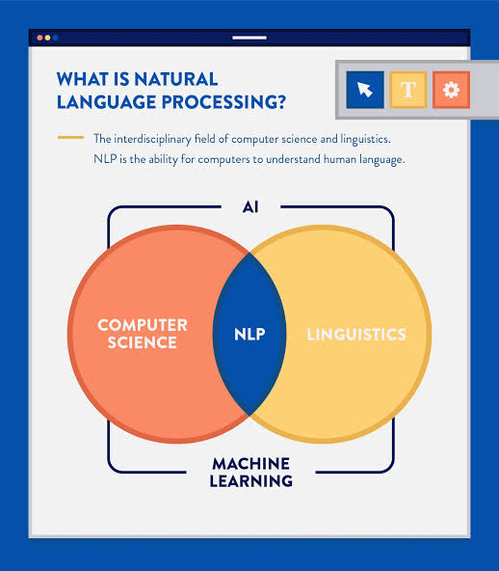

Slide 5
Applications of NLP
Grammar Checking Software ( eg: Grammarly) or writing platform such as Twinword Writer
Translation from one human language to another( eg: English to Italian)
Named Entity Recognition (NER)
Speech Recognition

Slide 6



Grammar Checking Softwares
Some of the common grammar checking softwares present today

Slide 7


What is Grammarly?
Grammarly is a technology company that develops a digital writing tool using artificial intelligence and natural language processing.
It was developed in 2009 by Alex Shevchenko and Max Lytvyn.

Slide 8
So what does Grammarly do?
As you type, Grammarly checks your text for hundreds of common and advanced writing issues. These checks involve :
Common grammatical errors like subject-verb agreement, article use, etc.
Contextual spelling mistakes and phonetic spelling mistakes
Irregular verb conjugations
It also provides synonym suggestions for improving readability and precision

Slide 9
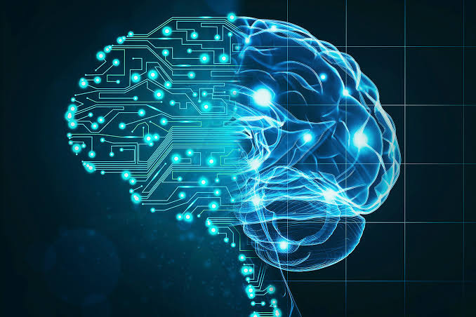

What goes on under the hood
Grammarly is powered by an advanced system that combines artificial intelligence techniques like machine learning, deep learning, and natural language processing.

Slide 10

How it's done
The first step is choosing high-quality training data for your system to learn from.
In Grammarly’s case, that data may take the form of a text corpus—a huge collection of sentences that human researchers have organized and labeled in a way that AI algorithms can understand.

Slide 11

For example
If you want your AI to learn the patterns of proper comma usage, for example, you need to show it sentences with incorrect commas, so it can learn what a comma mistake looks like. And you need to show it sentences with good comma usage, so it learns how to fix comma mistakes when it finds them.

Slide 12

Moreover..
AI systems also need feedback from humans. When lots of users hit “ignore” on a particular suggestion, for example, Grammarly’s computational linguists and researchers make adjustments to the algorithms behind that suggestion to make it more accurate and helpful.

Slide 13
Google Docs Grammar Check Tool
Most of us are pretty familiar with Google Docs. It is one of the easiest ways for teams to share and edit content.
And there are a lot of ways about how Google can improve your writing skills.
However, Google wants to dominate the game by introducing a new grammar suggestions product. With also includes a language translation feature!

Slide 14

Features
The company says that its AI can identify a wide range of errors and suggest fixes for them, “from simple grammatical rules like how to use articles in a sentence (like “a” versus “an”), to more complicated grammatical concepts such as how to use subordinate clauses correctly.”
In language translation, you can take a language like English and translate it to French.

Slide 15


Slide 16
Sources
Wikipedia
Grammarly Official Website
Tutorialspoint

Slide 17

THANK YOU

